Slide 1
03
Comlexity Anlysis
Time Complexity & Space Complexity
Liner Zhang

Slide 2
Assume
input.txt:
n→the number on lines input.txt→how many kinds of items needed to buy
k→the average number of purchase per item
price.txt:
m→the number of lines in price.txt→how many kinds of items market has
promotions.txt:
p→the number of lines in promotions.txt→how many kinds of promotions market has
a(constant)→the average length of each line in promotions.txt

Slide 3
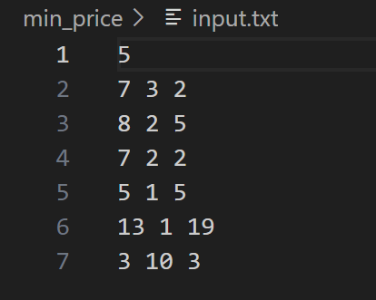
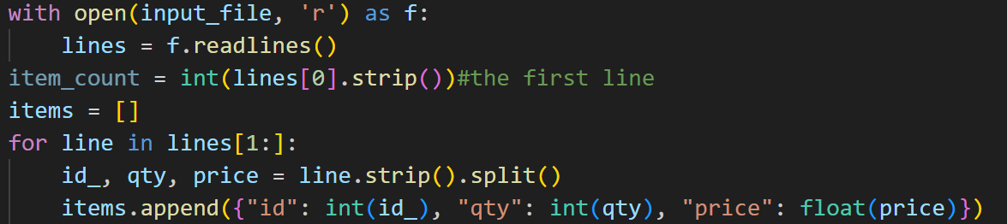
input.txt→items list→O(n)
lines(list) stores all the lines from the file in memory and the space required is O((n-1)*3+1).
O(1)
The items list stores (n-1) dictionaries, each with three keys, so its space complexity is O((n-1)*3).

Slide 4
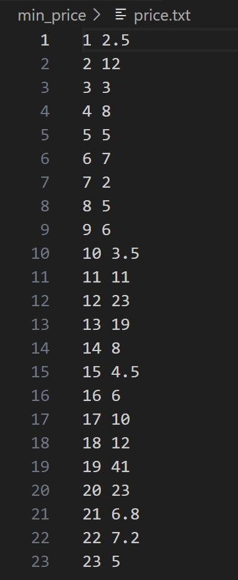
price.txt→prices dict→O(m)
price_lines(list) stores all the lines from the file in memory and the space required is O(m*2).
The prices dictionary stores a mapping of item IDs to prices, so its space complexity is O(m).

Slide 5
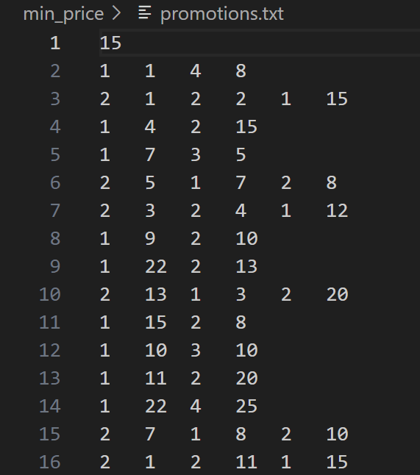
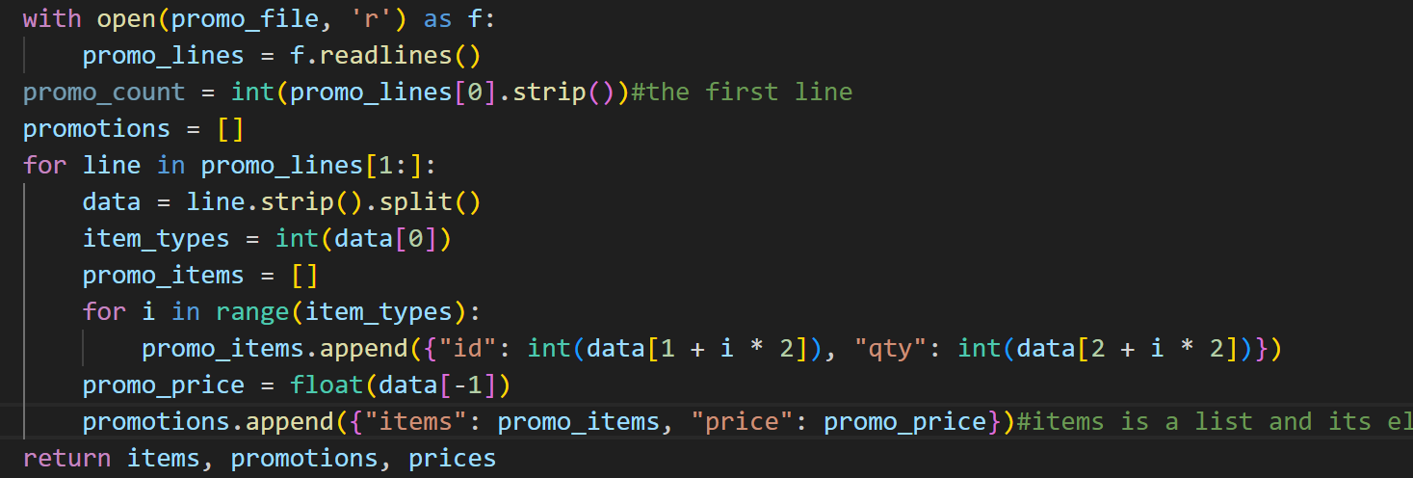
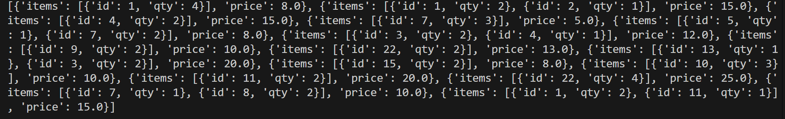
promotions.txt→promotions list→O(p)
promo_lines(list) stores all the lines from the file in memory and the space required is O(p*a).
each line contains [(a-2)/2] items, so the space required is O( [(a-2)/2] *2).
O(1)
O(([(a-2)/2] *2+1)*(p-1))

Slide 6
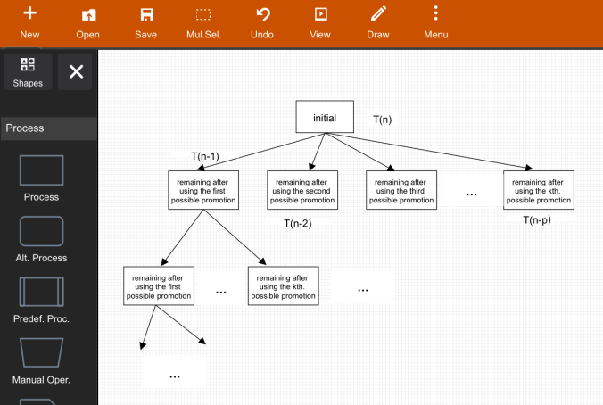
Recursive Tree
★T(n-k) means the left items after using the k.th promotion, which still has the same length.
★T(0) means no remaining.
T(n) =p+ T(n-1) + T(n-2) + T(n-3)...T(n-p)

Slide 7
Guess→Prove
★Assume:
number of levels: n*a(worst case)
cost of the i.th level: p^i*p=p^(i+1)
sum up all costs from all levels:
T(n)=p^1+p^2+....p^(n*a+2)=O(p^n)
★Prove:
Basic case: T(0) =1
nduction Case: T(n-1) = O(p^(n-1))....T(n-p) = O(p^(n-p)). T(n)=p+ T(n-1)+...T(n-p)= O(p^n)

Slide 8
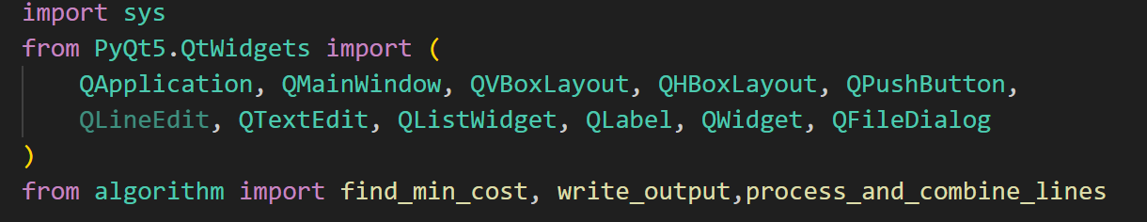
04
UI Design

Slide 9
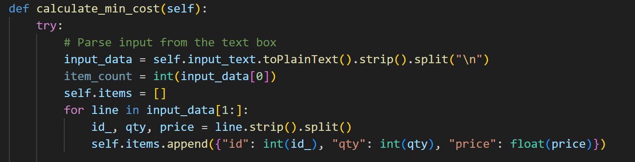
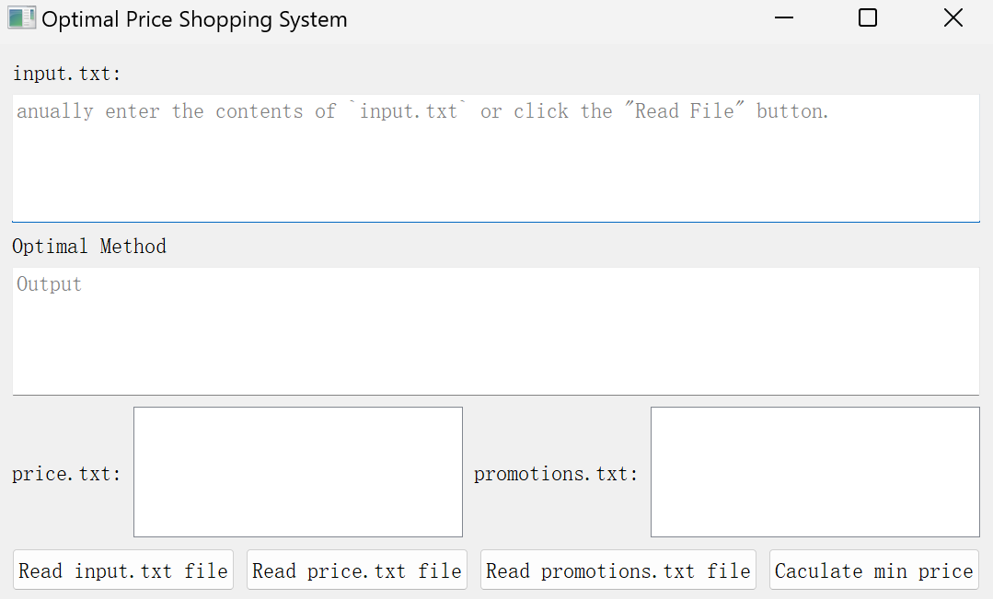
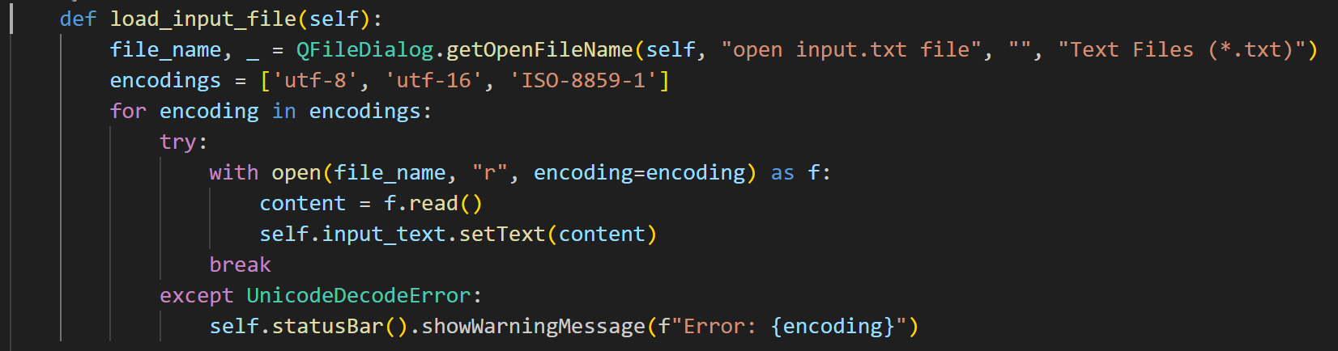
Two ways to get data
User can directly write down input text in this widget.
Because the system will eventually parse the data from the text widget in caculate process.
open a file selected by the user and if successful, it displays the content in the input text widget.

